Slide 1


Slide 2
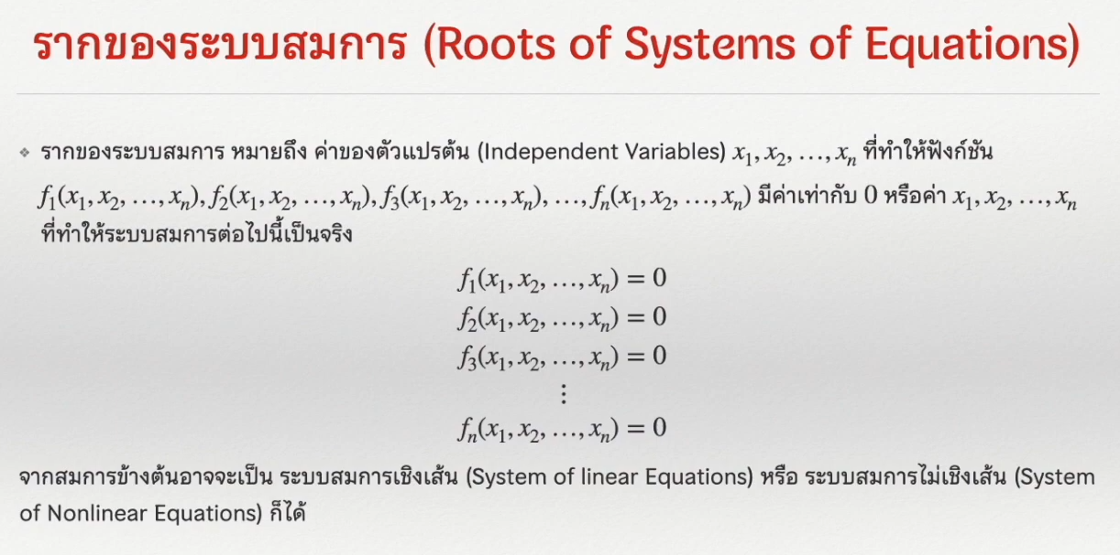

Slide 3
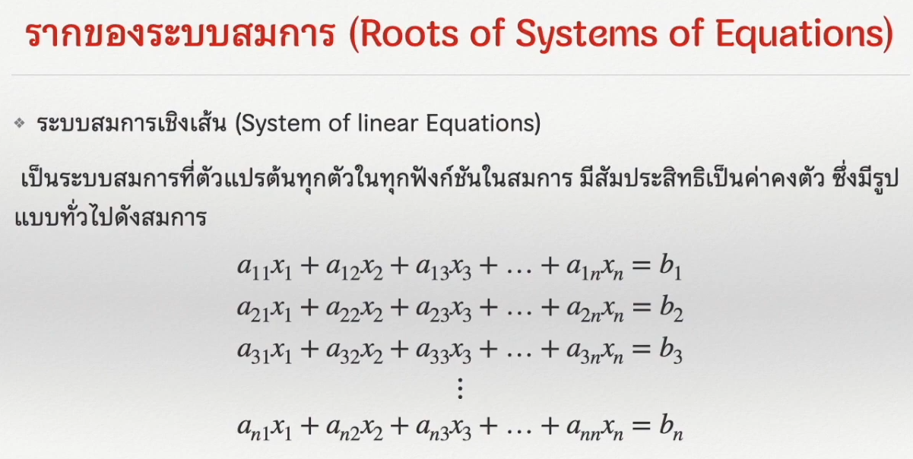

Slide 4
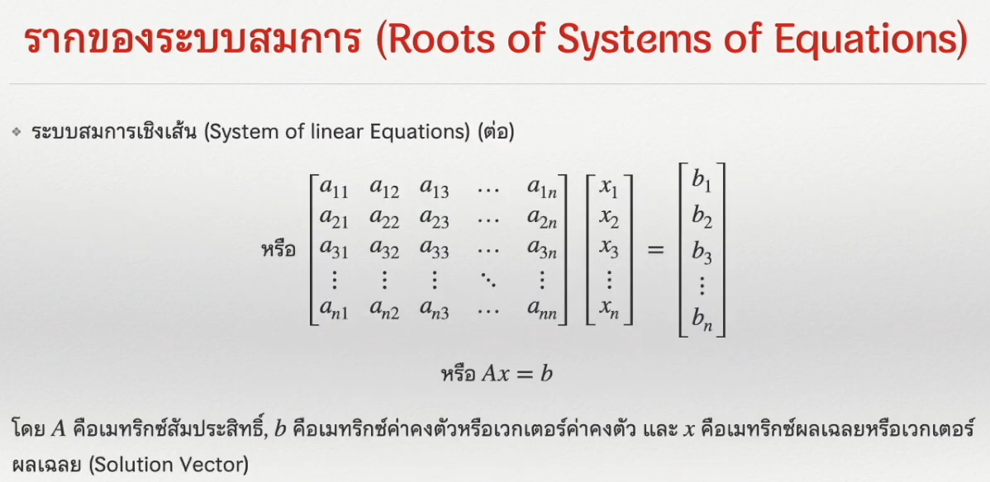

Slide 5
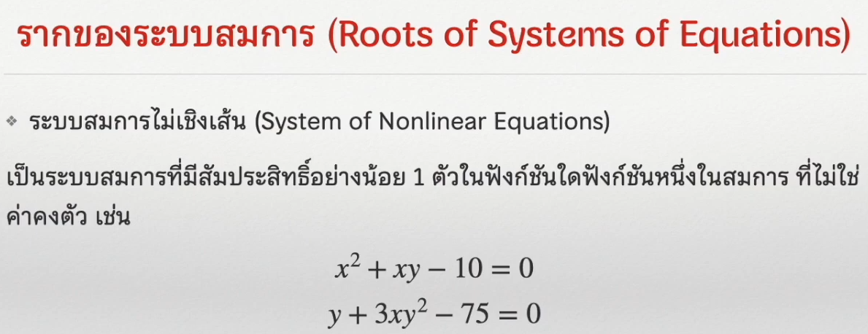

Slide 6
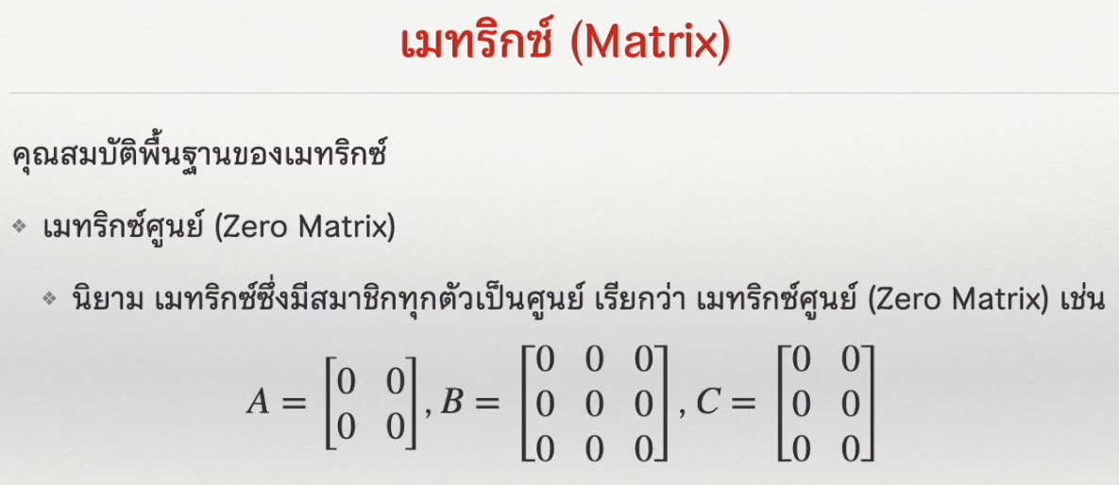

Slide 7
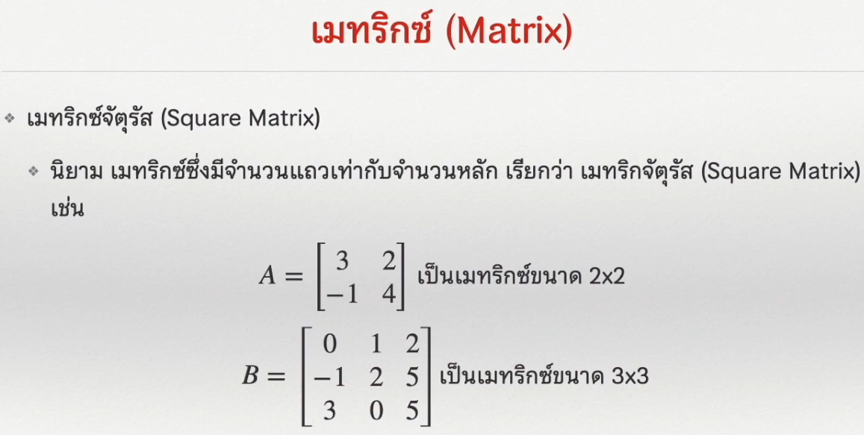

Slide 8
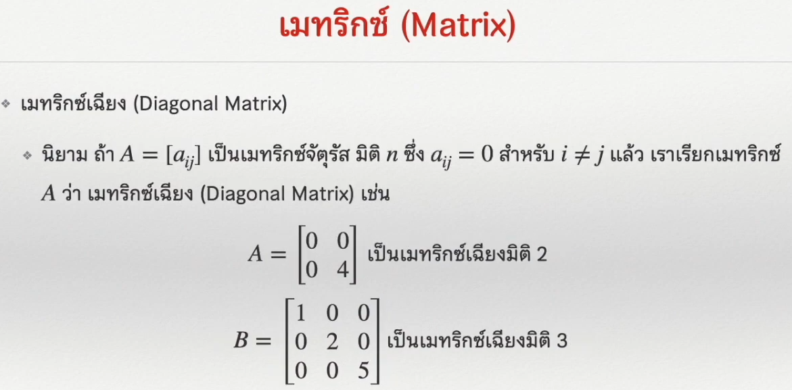

Slide 9
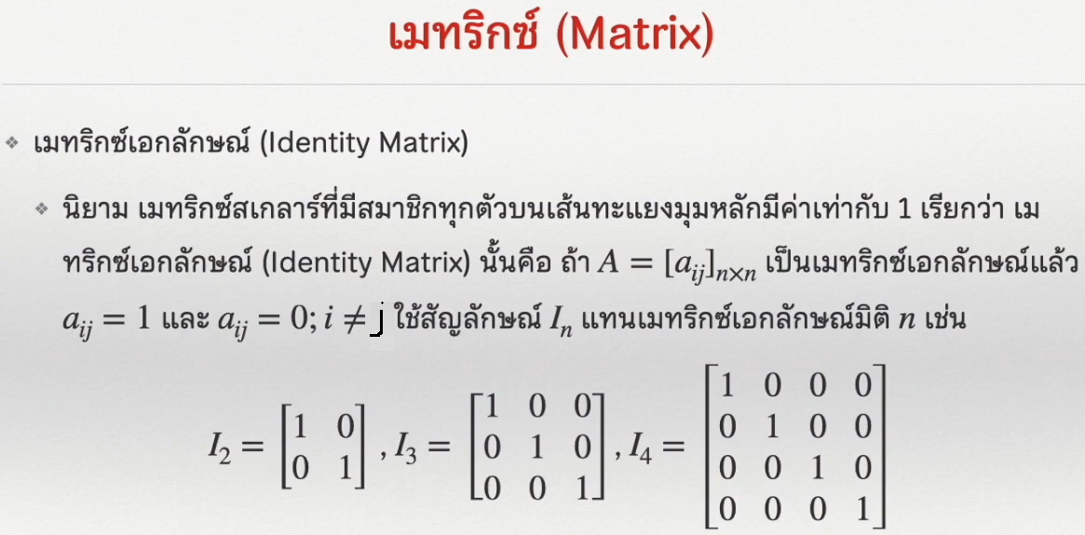

Slide 10
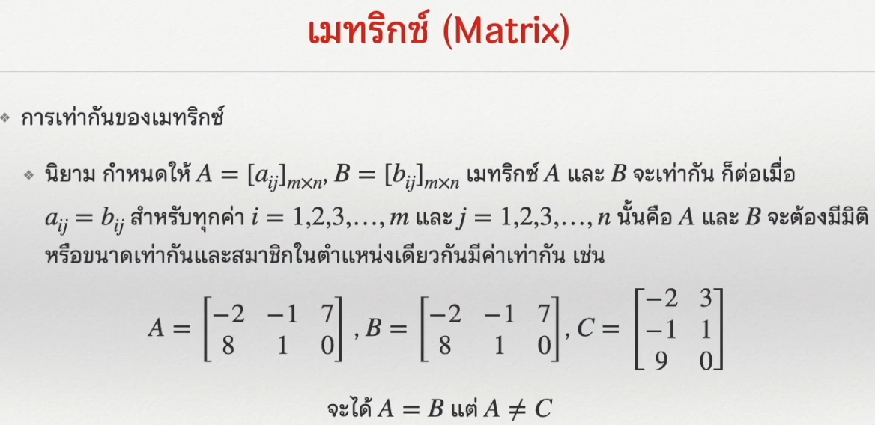

Slide 11
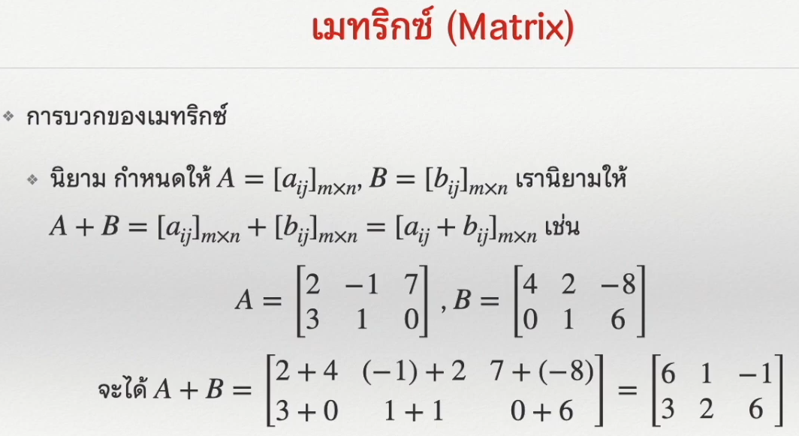

Slide 12
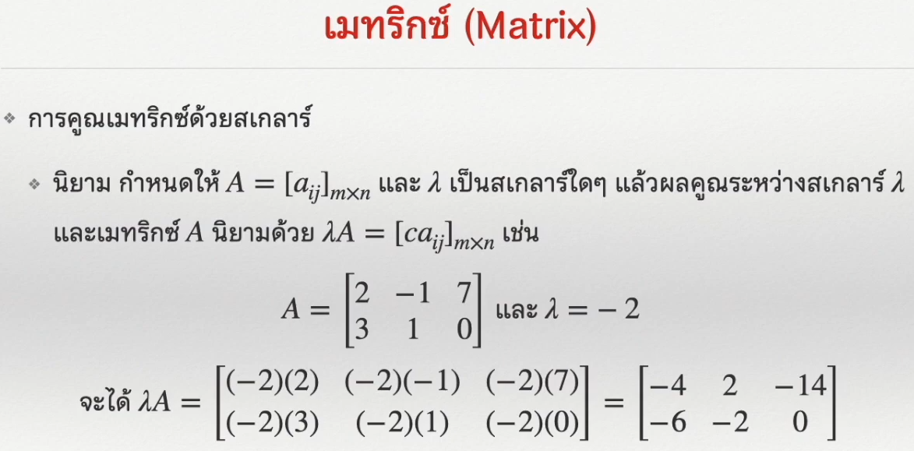

Slide 13
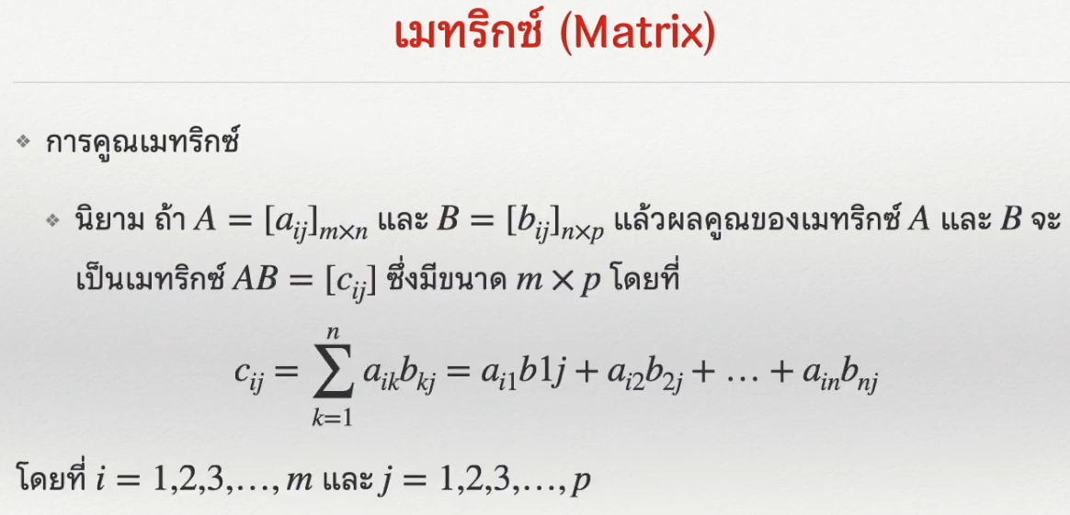

Slide 14
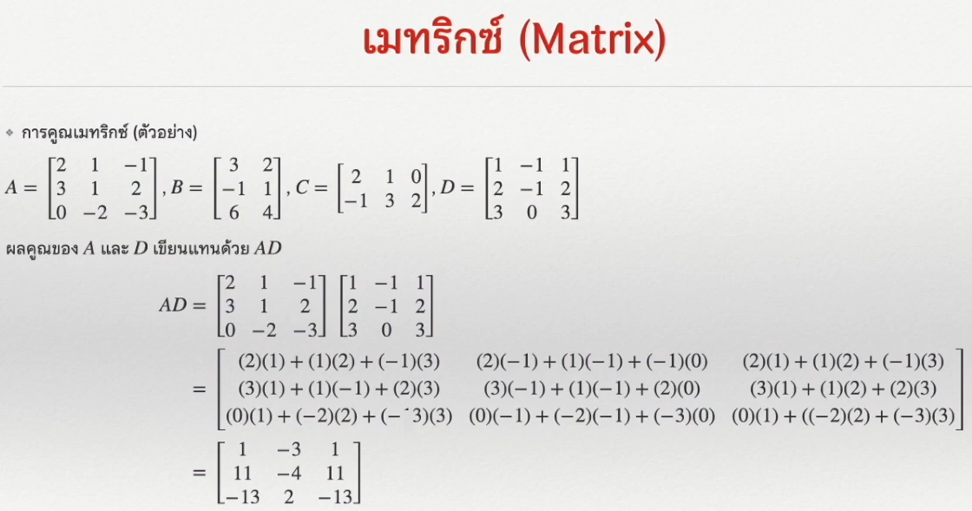

Slide 15
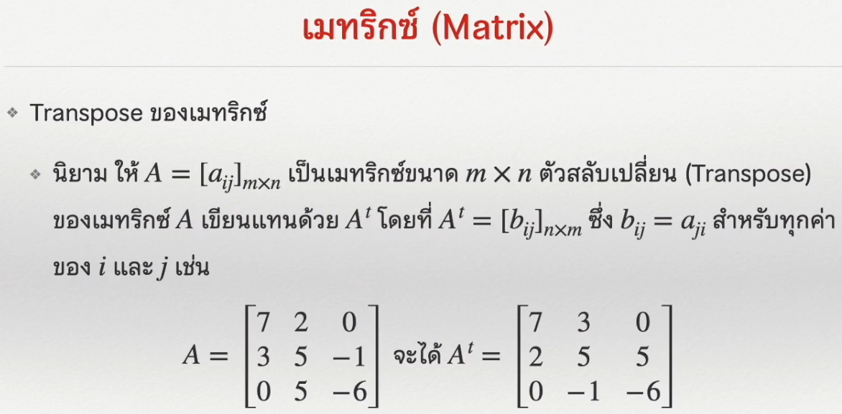

Slide 16
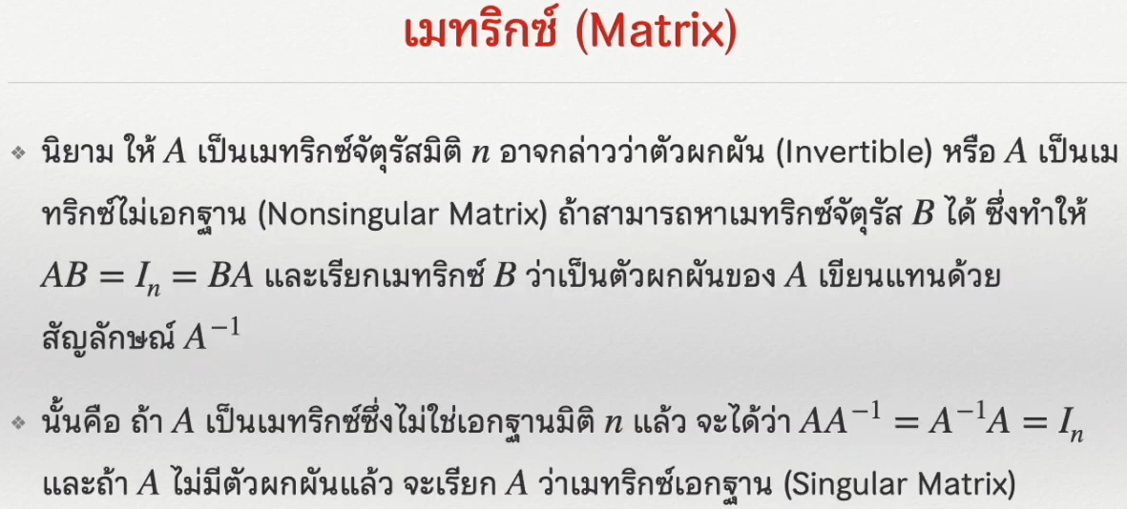

Slide 17
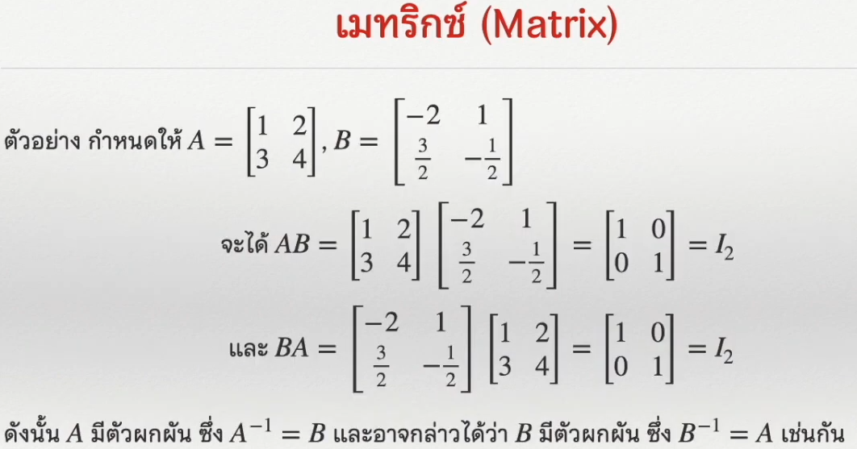

Slide 18
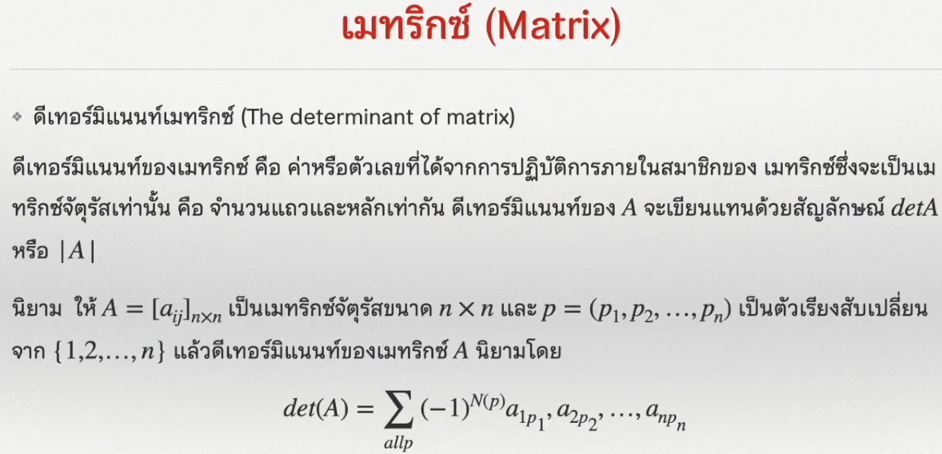

Slide 19
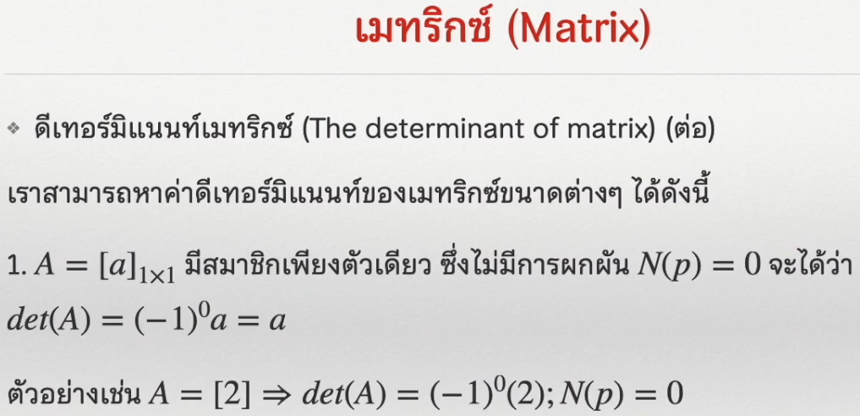

Slide 20
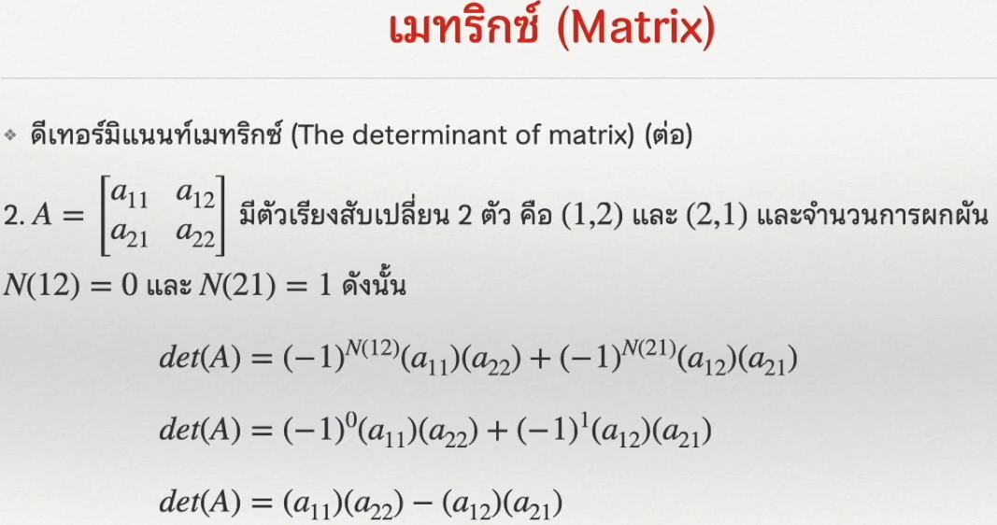

Slide 21
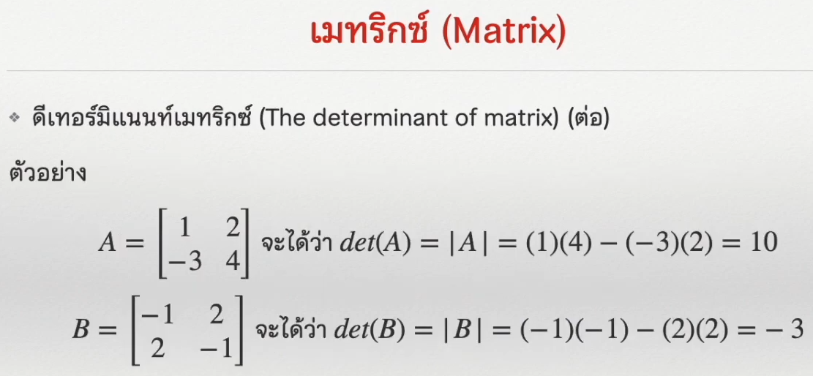

Slide 22
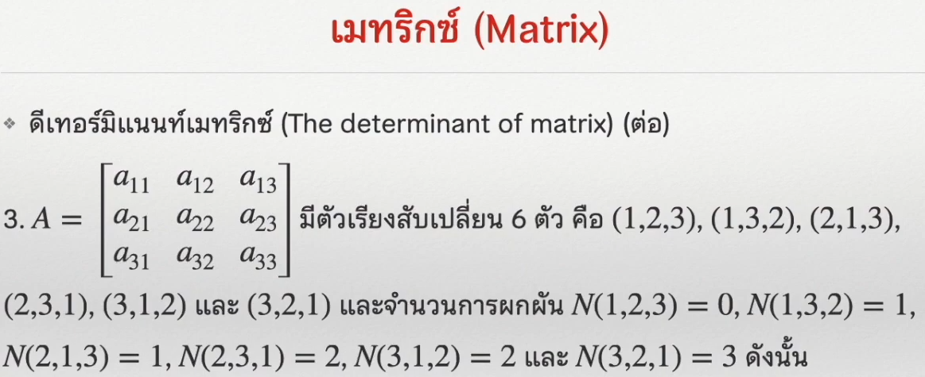

Slide 23
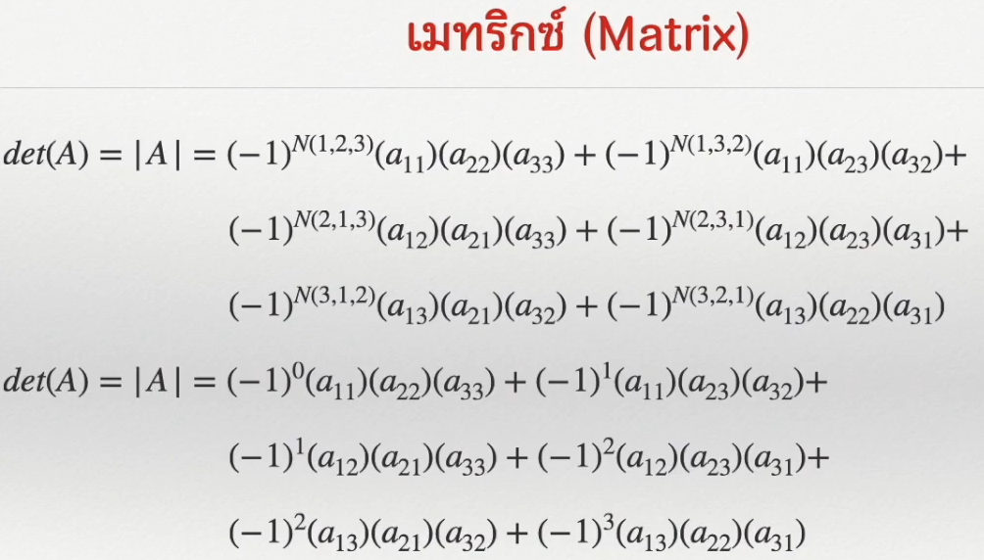

Slide 24
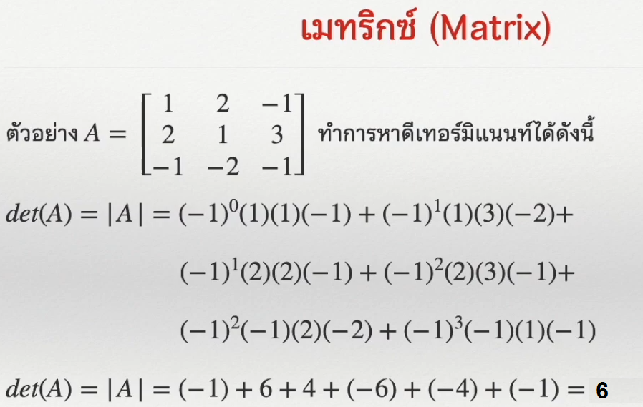

Slide 25
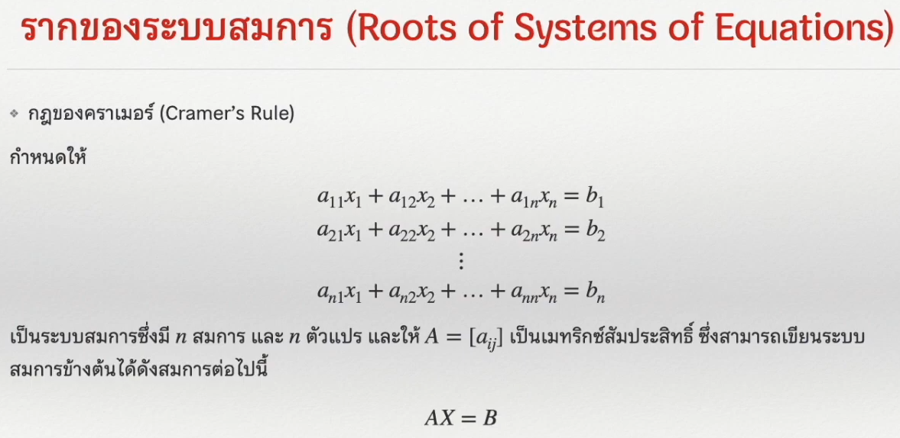

Slide 26
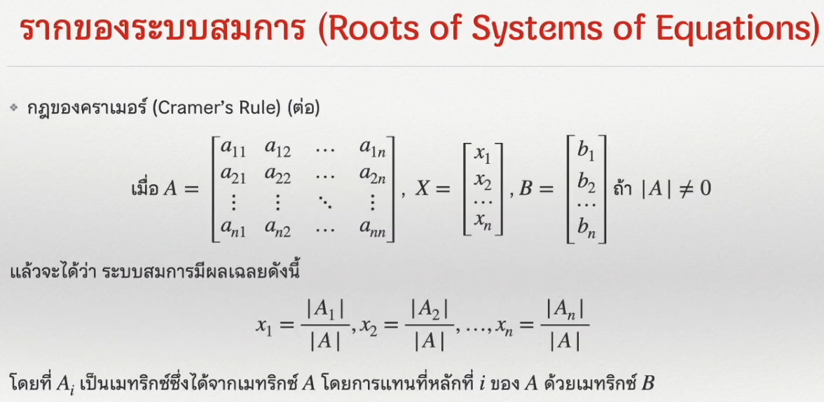

Slide 27
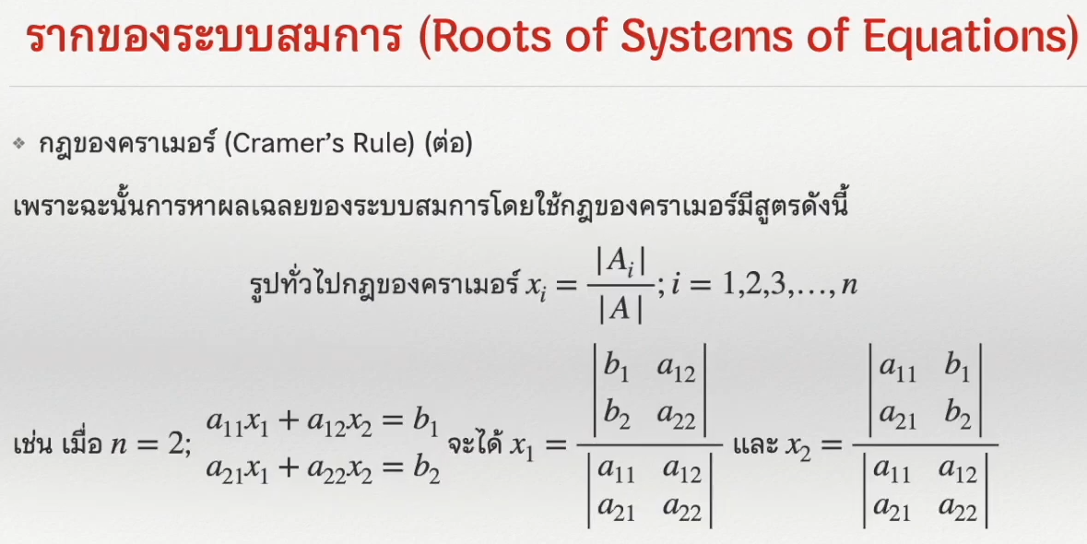

Slide 28
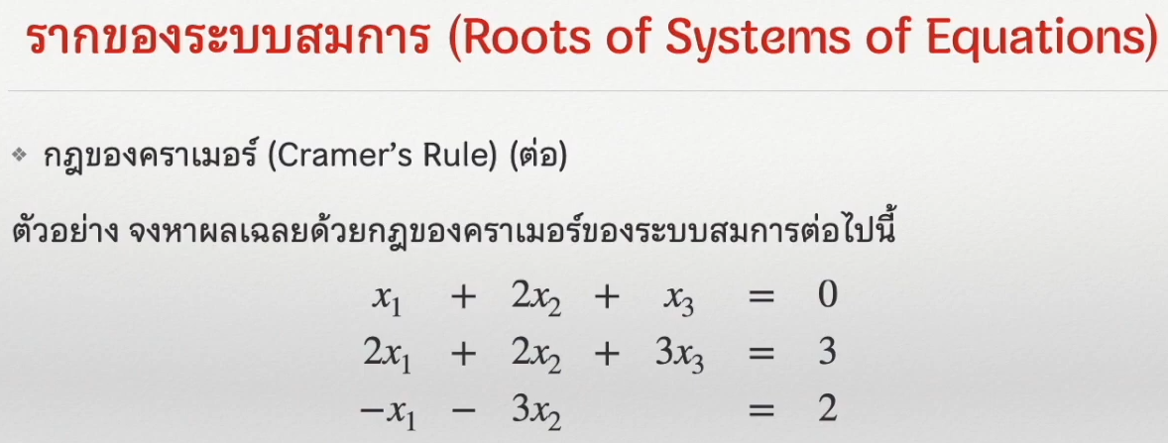

Slide 29
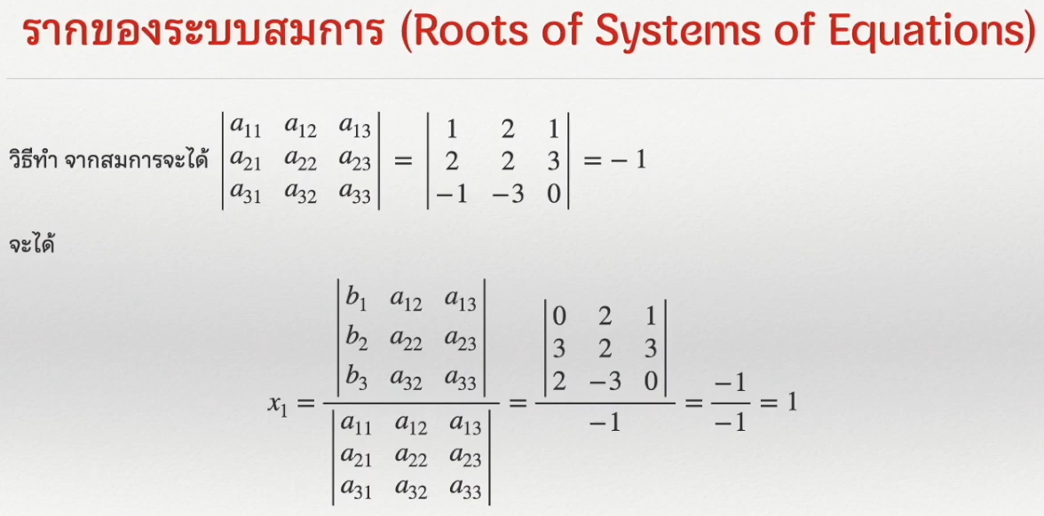

Slide 30
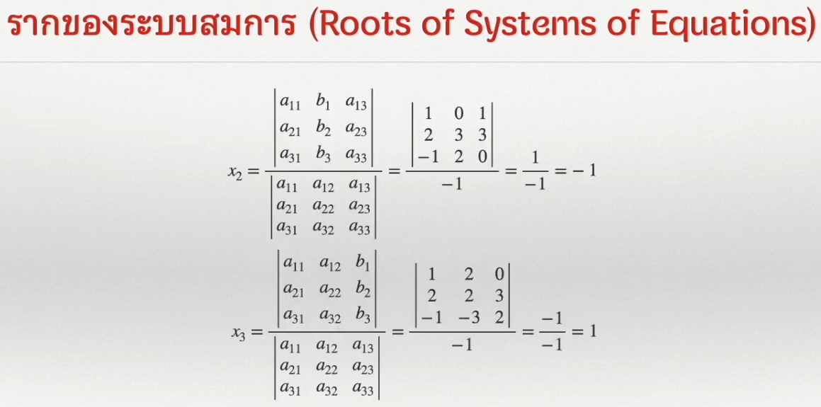

Slide 31


Slide 32


Slide 33
Add Two Matrices Using Numpy
import numpy as np
X = [[1, 2, 3],
[4, 5, 6],
[7, 8, 9]]
Y = [[9, 8, 7],
[6, 5, 4],
[3, 2, 1]]
result = np.array(X) + np.array(Y)
print(result)

Slide 34
Matrix Multiplication in NumPy
Example 1 : Matrix multiplication of 2 square matrices.
# importing the module
import numpy as np
# creating two matrices
p = [[1, 2], [2, 3]]
q = [[4, 5], [6, 7]]
print("Matrix p :")
print(p)
print("Matrix q :")
print(q)
# computing product
result = np.dot(p, q)
# printing the result
print("The matrix multiplication is :")
print(result)

Slide 35
Matrix Multiplication in NumPy
Example 2 : Matrix multiplication of 2 rectangular matrices.
# importing the module
import numpy as np
# creating two matrices
p = [[1, 2], [2, 3], [4, 5]]
q = [[4, 5, 1], [6, 7, 2]]
print("Matrix p :")
print(p)
print("Matrix q :")
print(q)
# computing product
result = np.dot(p, q)
# printing the result
print("The matrix multiplication is :")
print(result)

Slide 36
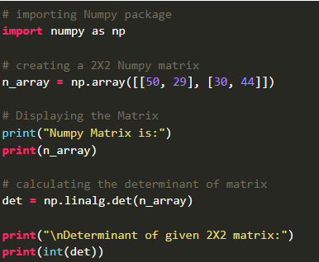
Calculate the determinant of a matrix using NumPy
Example 1: Calculating Determinant of a 2X2 Numpy matrix using numpy.linalg.det() function

Slide 37
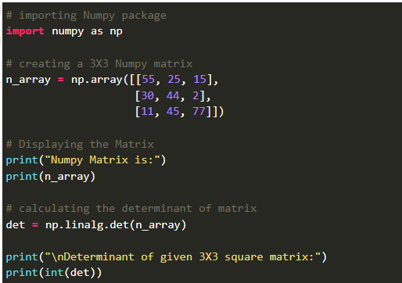
Calculate the determinant of a matrix using NumPy
Example 2: Calculating Determinant of a 3X3 Numpy matrix using numpy.linalg.det() function

Slide 38
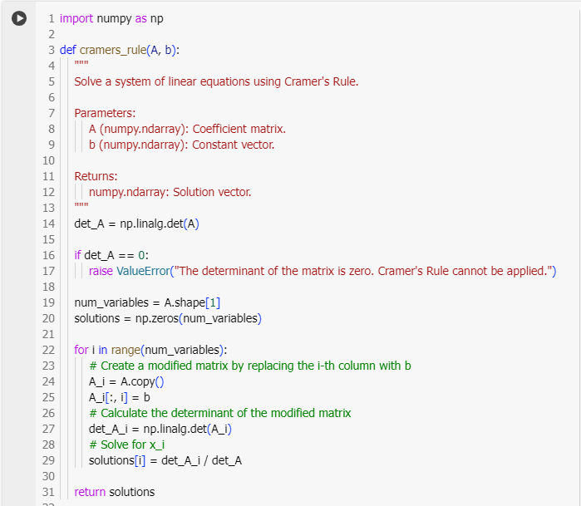
System of Linear Equations in three variables using Cramer’s Rule

Slide 39
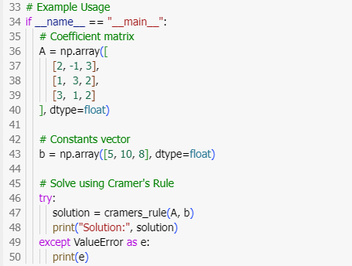
System of Linear Equations in three variables using Cramer’s Rule

Slide 40
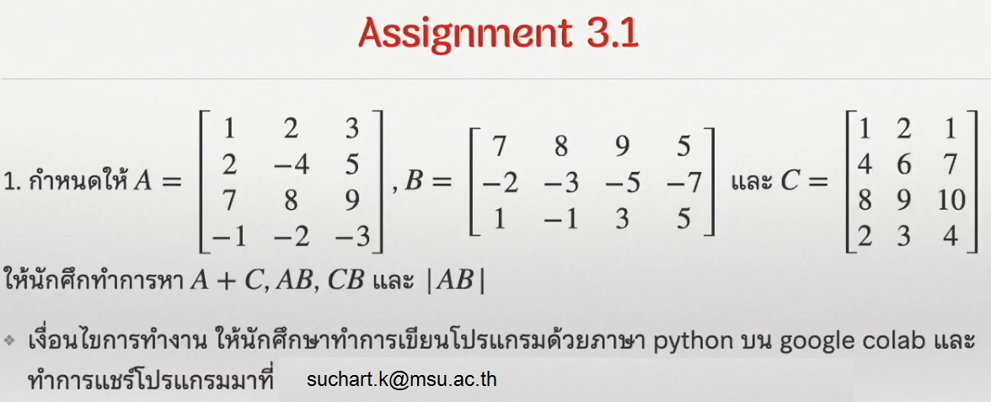

Slide 41
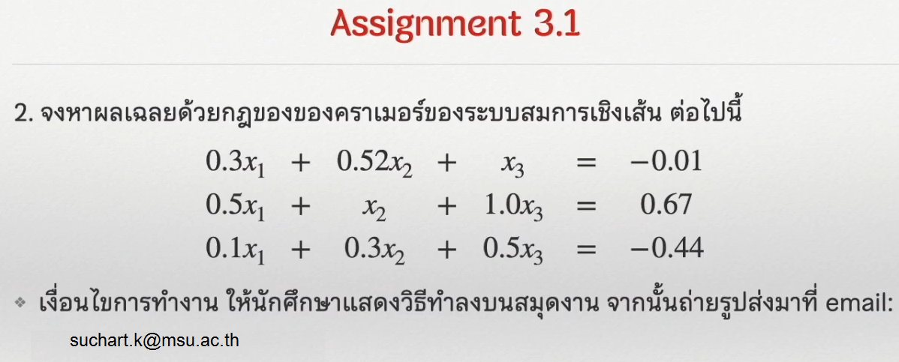

Slide 42
